Slide 1
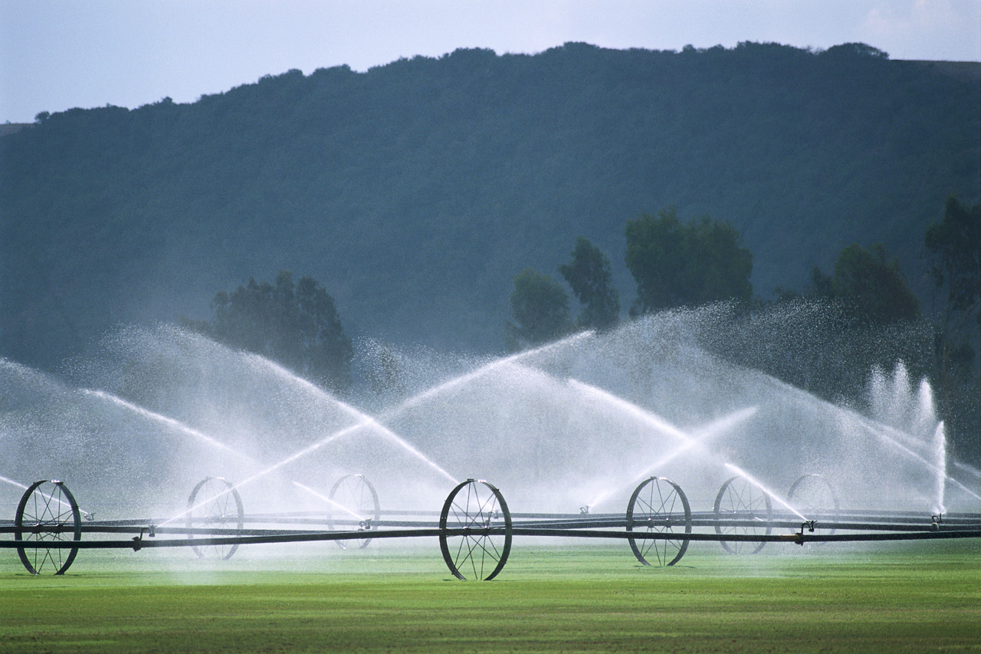
Division of Water Rights
WaterRights.utah.gov

Slide 2
Supplemental Groups 101
Training for Licensed
Engineers and Surveyors
Frank Quintana, PE
Tuesday, November 12, 2013

Slide 3

Supplemental
Groups?

Slide 4
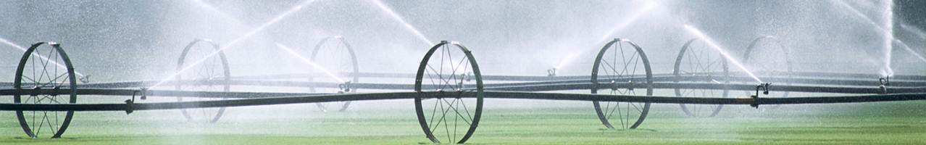
What are the basics?
What to review?
What are the guidelines?

Slide 5
What are the basics?

Slide 6
Water Use Group
Supplemental Group
Water Right # | Stockwatering ELUs
15-328
15-330
15-331 | 400
15-1262
15-1307
Water Right # | Stockwatering ELUs
15-328 | 85
15-330 | 85
15-331 | 85
15-1262 | 123
15-1307 | 22

Slide 7
What to review?

Slide 8
For Each Water Right
Original application
Original Approval
Order(s) of the State Engineer
(Memorandum Decisions)
Sole supply
Number of group(s)
Total of each group (acreage, ELUs, etc.)

Slide 9
What are the guidelines?

Slide 10
Flow Proration
ELU Diversion Duty 0.028 ac-ft/yr
0.015 cfs x 400 ELUs ÷ 0.071 cfs
84.51 ELUs x 0.028 ac-ft/ELU-yr
0.015 cfs x 723.97 ac-ft/cfs-yr
Info to fill out
DECLARATION OF BENEFICIAL USE FORM

Slide 11
SEPARATE PROCESS
This what the Division is asking
owners in the DECLARATION of BENEFICIAL USE FORM
DEFINING THE OWNERSHIP INTEREST
OF THE OWNERS.
THIS A SEPARATE PROCESS

Slide 12
SEPARATE PROCESS
DECLARATION of BENEFICIAL USE FORM
DEFINING OWNERSHIP INTEREST
THIS A SEPARATE PROCESS

Slide 13
Average Method
ELU Diversion Duty 0.028 ac-ft/yr
400 ELUs ÷ 5
80 ELUs x 0.028 ac-ft/ELU-yr
0.015 cfs x 723.97 ac-ft/cfs-yr
DECLARATION FORM

Slide 14
Priority Method
ELU Diversion Duty 0.028 ac-ft/yr
15.93 ac-ft/yr ÷ 0.028 ac-ft/ELU-yr
0.022 cfs x 723.97 ac-ft/cfs-yr
296.43 ELU x 0.028 ac-ft/ELU-yr
DECLARATION FORM

Slide 15

Irrigation Duty 4.0 ac-ft/ac-yr
ELU Diversion Duty 0.028 ac-ft/ELU-yr
$$\frac{1 cfs}{60 acres}= \frac{Flow}{Acreage}$$
0.656 cfs x 723.97 ac-ft/cfs–yr x 214 days ÷ 365 days

Slide 16
Supplemental Group(s) = quantification
Quantification ≠ Identifying ownership interest
Look for signs of quantification
Use guidelines

